Slide 1
Collaborating with OT in a Pediatric Mental Health Setting

Slide 2
Table of Contents
Overview of OT
OT’s Role in Pediatric Mental Health Setting
Collaboration
Co-Treatment
Documentation
Intake
Consultation
Treatment

Slide 3
Overview of OT: Definition
“Occupational therapy is the only profession that helps people across the lifespan to do the things they want and need to do through the therapeutic use of daily activities (occupations). Occupational therapy practitioners enable people of all ages to live life to its fullest by helping them promote health, and prevent—or live better with—injury, illness, or disability.”
What is Occupational Therapy? (n.d.).

Slide 4
Overview of OT: What are occupations?
Meaningful activities that OCCUPY one’s time throughout the day
Examples Include:
Activities of Daily Living (ADLs)
Dressing, Feeding, Grooming
Instrumental Activities of Daily Living (IADLs)
Caregiving, Driving/Community Mobility, Home Management, Shopping, Meal Preparation
Sleep
School/Work
Play/Leisure
Social Participation

Slide 5
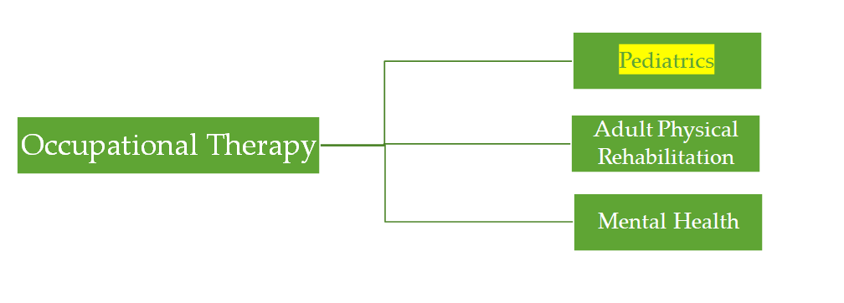
Overview of OT: General Practice Areas

Slide 6
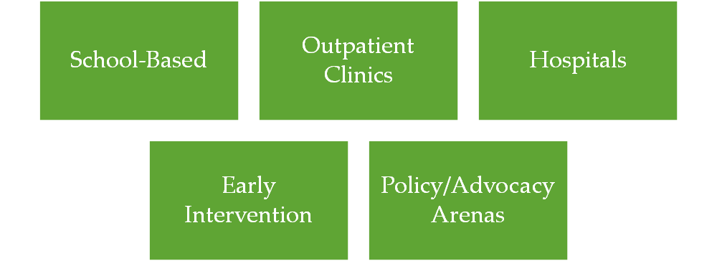
Overview of OT: Pediatric Practice Settings

Slide 7
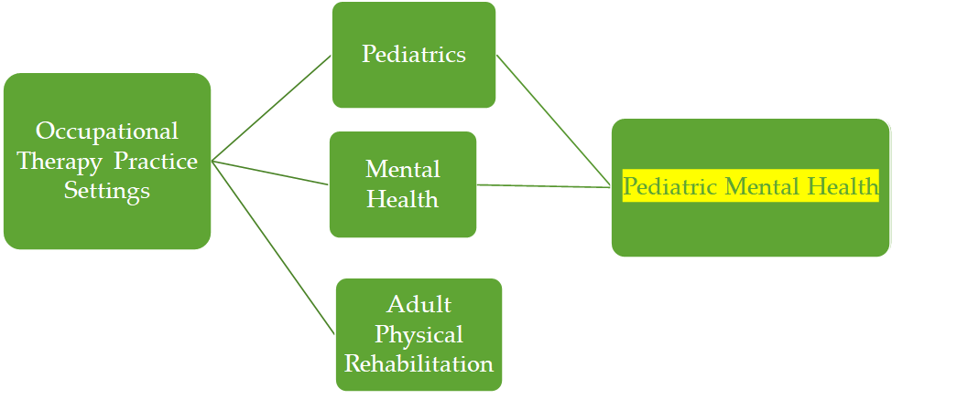
Overview of OT: Emerging Practice Settings

Slide 8
OTs Role in Pediatric Mental Health: Origins
Increased understanding of the impact that symptoms of mental health diagnoses/concerns have on meaningful and fruitful engagement in occupation
Feelings of self-confidence
Levels of independence
Rate of skill development

Slide 9
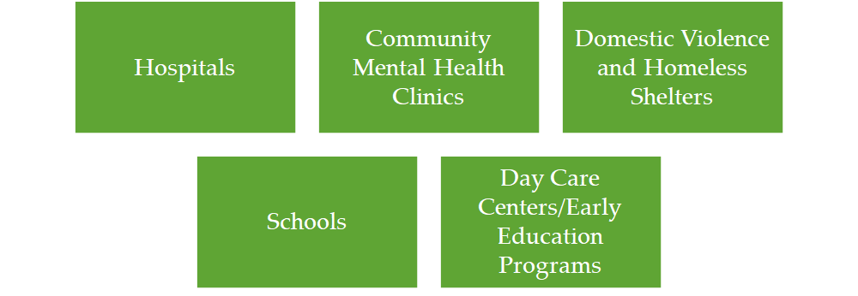
OTs Role in Pediatric Mental Health: Different Settings

Slide 10
OTs Role in Pediatric Mental Health: Role

Slide 11
OTs Role in Pediatric Mental Health: Role

Slide 12
OTs Role in Pediatric Mental Health: Role

Slide 13
Options for Collaboration

Slide 14
Co-Treatment: Benefits of Collaboration
Benefits of integrated behavioral health services/collaboration between a primary therapist and an allied health professional, like an OT, can lead to:
Increased capacity to holistically address client’s needs, especially complex/under-resourced clients (Sulkowski et al., 2011)
Improved quality of life and emotional functioning (Bird et al., 2012)
Reduced hospitalizations and emergency department visits (Rodriguez et al., 2019)
Increased access to care (Bridges et al., 2014)
Testimonials from Primary Therapists
“OT services have been instrumental as mental health therapist because I’ve learned tools and interventions to support my clt’s with sensory-based needs.”
OT services have guided my practice because the psychoeducation information I’ve learned through OT consultations have encouraged me to further assess for sensory related problems—thus providing holistic services.

Slide 15
Co-Treatment: Testimonials from Primary Therapists
Testimonials from Primary Therapists
OT services have been instrumental as mental health therapist because I’ve learned tools and interventions to support my clt’s with sensory-based needs.
OT services have guided my practice because the psychoeducation information I’ve learned through OT consultations have encouraged me to further assess for sensory related problems—thus providing holistic services.
Having joint sessions with an OT has really helped me understand how incorporating sensory activities while processing can help children decrease aggressive behaviors
I have found myself utilizing OT strategies such as focusing on how the child’s body feels and what the child’s body might be asking for (pressure, movements, slowing down) with other children who’s caregivers have not reported sensory issues
I definitely feel that having the perspective of an OT in the session has really helped me reflect and consider other angles to client’s triggers and family systems which helps with brainstorming and problem solving with families.

Slide 16
Co-Treatment: Common OT referral presentations
☐ Does this child’s difficulty with emotion regulation directly impact frequency of calm, developmentally appropriate participation in play or activities with others (i.e. family or friends)?
☐ Do the mental health symptoms of this child impact his or her ability to complete activities of daily living (i.e. dressing, bathing, toileting) to the level that is expected of the child developmentally?
☐ Are mental health symptoms exacerbated when this child is faced with completing an activity that involves components of sensory processing (sights, sounds, smells, touch, taste), which then ultimately impedes performance?
☐ Does this child become dysregulated during certain aspects of mealtime (potentially due to food selectivity/picky eating, hyperactivity, sensory sensitivities, etc.), impacting this child’s ability to actively engage in this occupation overall?
☐ On a consistent basis, do the mental health challenges of this child disrupt their ability to assume the role of a student at school to the best of their abilities? Are there other specific environments (i.e. home, community outings) in which mental health difficulties impact overall levels of performance in a variety of occupations as well?
☐ Does this child have difficulty fully completing tasks, consistently adhering to routines, or initiating engagement overall due to inattention, hyperactivity, or an overall lack of initiation that is related to mental health challenges?

Slide 17
Co-Treatment: What might it look like?
General examples
OT provides individualized skill-building support (Rehab) while primary therapist focuses on psychological processing (Therapy)
OT provides occupation-based analysis and recommendations (e.g. breakdown of sensory, motor, cognitive, socioemotional components of daily activities) during collaterals while primary therapist supports caregivers with therapeutic strategies
OTs and primary therapists can co-facilitate rehab groups to support clients with skill-building

Slide 18
Case Study: Selena | Let’s Zoom Out!
How did Selena get referred to a pediatric mental health OT?
Caregivers referred to VIP for Triumph class (FASD)
MH Diagnosis of Childhood Emotional Disorder, unspecified
☒ Does this child’s difficulty with emotion regulation directly impact frequency of calm, developmentally appropriate participation in play or activities with others (i.e. family or friends)?
☒ Does this child have difficulty fully completing tasks, consistently adhering to routines, or initiating engagement overall due to inattention, hyperactivity, or an overall lack of initiation that is related to mental health challenges?
Regional Center
Services
Community-
Based
Mental Health Services
School-Based Services
Inpatient Services
Early Intervention
Services
Notes:
Image: https://violenceinterventionprogram.org/about-vip/

Slide 19
Case Study: Selena | Let’s Zoom In!
5.3 yr. Old Latinx Girl
Lives with adoptive parents (maternal grandparents), older bio sister (12 yo), younger bio brother (4 yo)
Consult w/ Primary Therapist
Challenges with emotional regulation→ aggression towards younger sibling
Challenges with adhering to routine→ hyperactivity & dysregulation during sleep (sleeping at 2am, waking up at 6am)
Strengths: Loves coloring and books

Slide 20
Case Study: Selena | Co-Treatment
Before referring to OT, primary was only doing collaterals w/ caregivers due to client’s hyperactivity
OT Interventions
Individualized Night-time Routine Coloring Page
Yoga Coloring Cards
Turn-Taking Games w/ Sibling with Focus on Positive Communication (e.g. stuffed animal restaurant game, animal charades, “make a ______” games online)
Primary Therapist Interventions
Supports caregiver in practicing skills discussed during collaterals in vivo
Limit-setting, incentives, praise
Supports client in emotion processing
Notes:
Simultaneous
Venn diagram

Slide 21
Documentation: What can OTs bill?

Slide 22
Documentation
Intake
H2000
Consultation
Group plan development note
Co-Treatment
Basic Guidelines
Can write separate notes
Don’t have to discuss each other’s contributions in note
Rehab & Therapy
Each provider can bill for full time
Collateral & Collateral
Each provider can bill for full time
Plan Development
Each provider can bill for full time
Rehab & Rehab
Two-biller?

Slide 23
References
What is Occupational Therapy? (n.d.). Retrieved from https://www.aota.org/Conference-Events/OTMonth/what-is-OT.aspx.
Bird, S. R., Noronha, M., Kurowski, W., Orkin, C., & Sinnott, H. (2012). Integrated care facilitation model reduces use of hospital resources by patients with pediatric asthma. Journal for Healthcare Quality: Official Publication of the National Association for Healthcare Quality, 34(3), 25–33. https://doi.org/10.1111/j.1945-1474.2011.00143.x.
Bridges, A. J., Andrews, A. R. I., Villalobos, B. T., Pastrana, F. A., Cavell, T. A., & Gomez, D. (2014). Does integrated behavioral health care reduce mental health disparities for Latinos? Initial findings. Journal of Latina/o Psychology, 2(1), 37–53. https://doi.org/10.1037/lat0000009.
Rodríguez, E.M., Gulbas, L.E., George-Jones, J. et al. Interdisciplinary Perspectives on an Integrated Behavioral Health Model of Psychiatry in Pediatric Primary Care: A Community-Based Participatory Research Study. Community Ment Health J 55, 569–577 (2019). https://doi.org/10.1007/s10597-018-0330-0
Sulkowski, M. L., Wingfield, R. J., Jones, D., & Coulter, W. A. (2011). Response to intervention and interdisciplinary collaboration: Joining hands to support children's healthy development. Journal of Applied School Psychology, 27(2), 118-133.
Notes:
Could cite somewhere: https://www.aota.org/-/media/Corporate/Files/AboutOT/Professionals/WhatIsOT/MH/Facts/MH%20in%20Children%20and%20Youth%20fact%20sheet.pdf

