Slide 1
CA-LEND Leadership Project
Final Presentation
Involving an Interdisciplinary Systems of Care in Pediatric Bioethics and End of Life Care
Type: CE
Project Team
Angel Reyes (Public Health)
Sheela Rao (Supervisor)
07 May 2025

Slide 2
ABSTRACT
This leadership project developed an SEO-optimized article posting to support families, providers, and interdisciplinary teams to navigate the relationship between provider and patient, along with the potential role of families within interdisciplinary care teams.
The Aims of this project are too:
Facilitate the development of trust within care teams.
Elevate the role of families or supportive individuals.
Influence future pediatric bioethics guidelines.

Slide 3
Project Plain Language Summary
This project creates a simple, family-centered article post. It helps families and care teams make informed, culturally respectful decisions about end-of-life care. The goal is to support families with easy-to-understand, compassionate information.
Family-centered article to support end of life decisions

Slide 4

Brief Rationale and/or Background for Project/ Product
The Hastings Center for Bioethics received a grant to include pediatrics in its end-of-life guidelines and ensure that it became an open-access material for physicians worldwide.
Within this document, there was a gap for pediatrics.
The opportunity for filling this gap:
  Practical Significance
  Conceptual / Theoretical Significance
Notes:
Rationale/ Need for Project/
Why is this important?
Background: This slide/ section sets the stage for why the project is important and any background information that has been reviewed.
Consider these questions:
Why is this important?
What is the gap that you're trying to address with this project?
Suggested Strategies for Answering Above Questions
Lit Review
Best Practice Guidelines Review
Interview Key Stakeholders

Slide 5

Presentation of Project
https://www.Subthesis.com/CHLAProject
Notes:
What is the product? Showcase your product!
Who is the intended audience?
What is the proposed impact?
Any anticipated barriers to and/or strategies for maximum dissemination?

Slide 6
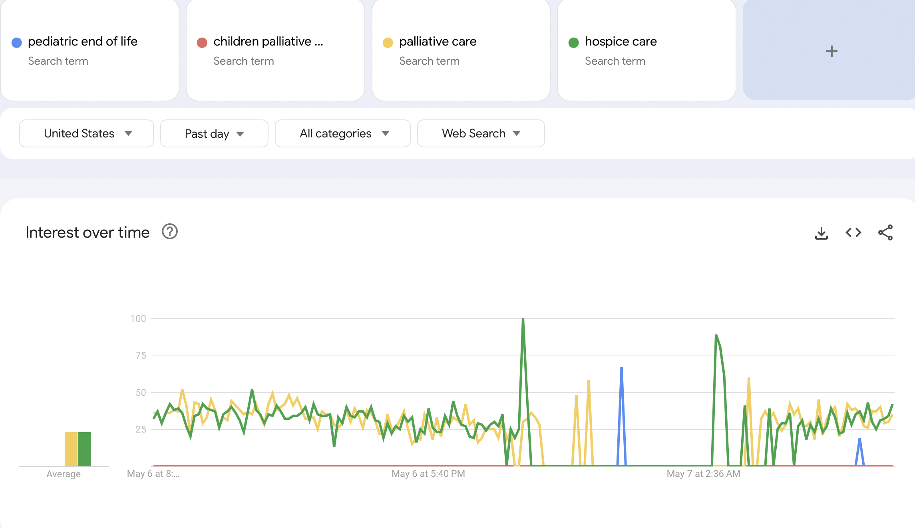
Notes:
What is the product? Showcase your product!
Who is the intended audience?
What is the proposed impact?
Any anticipated barriers to and/or strategies for maximum dissemination?

Slide 7
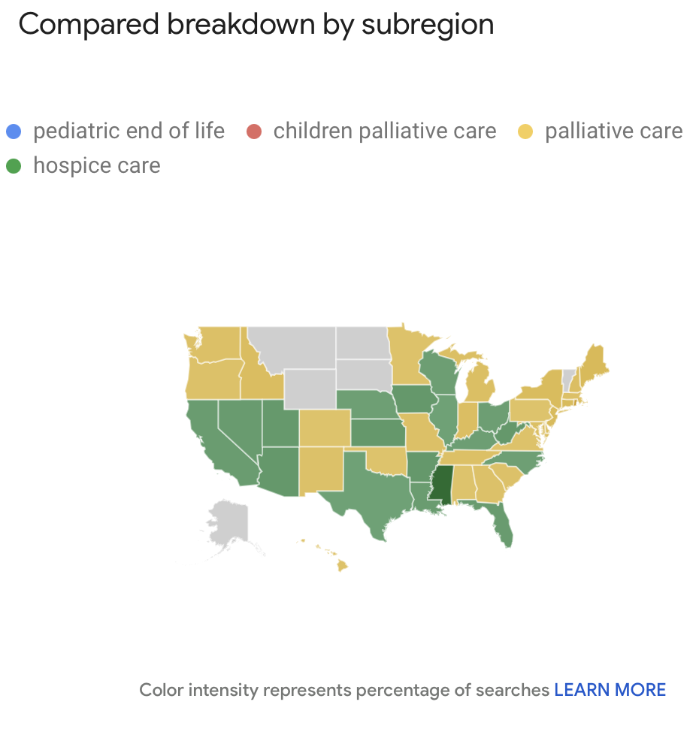
Notes:
What is the product? Showcase your product!
Who is the intended audience?
What is the proposed impact?
Any anticipated barriers to and/or strategies for maximum dissemination?

Slide 8
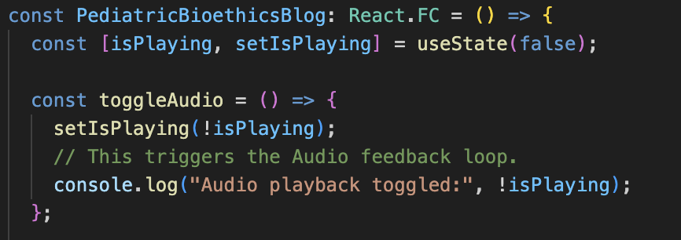
Notes:
What is the product? Showcase your product!
Who is the intended audience?
What is the proposed impact?
Any anticipated barriers to and/or strategies for maximum dissemination?

Slide 9
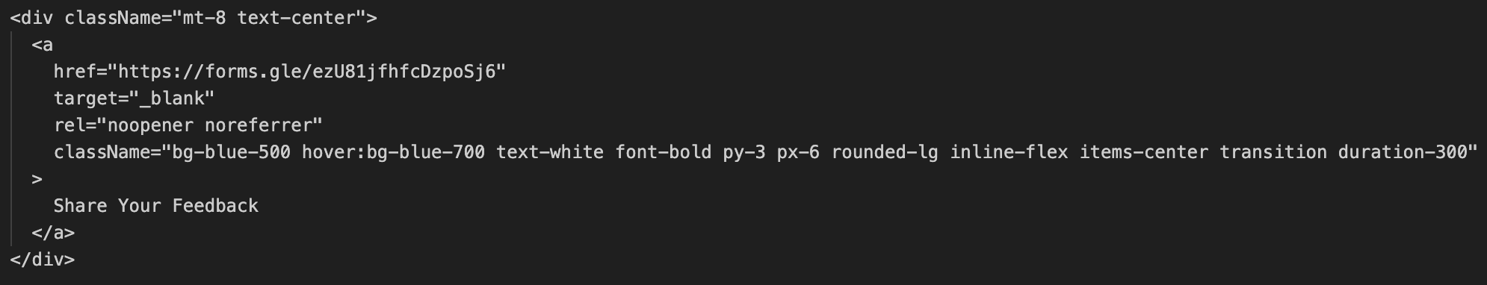
Notes:
What is the product? Showcase your product!
Who is the intended audience?
What is the proposed impact?
Any anticipated barriers to and/or strategies for maximum dissemination?

Slide 10
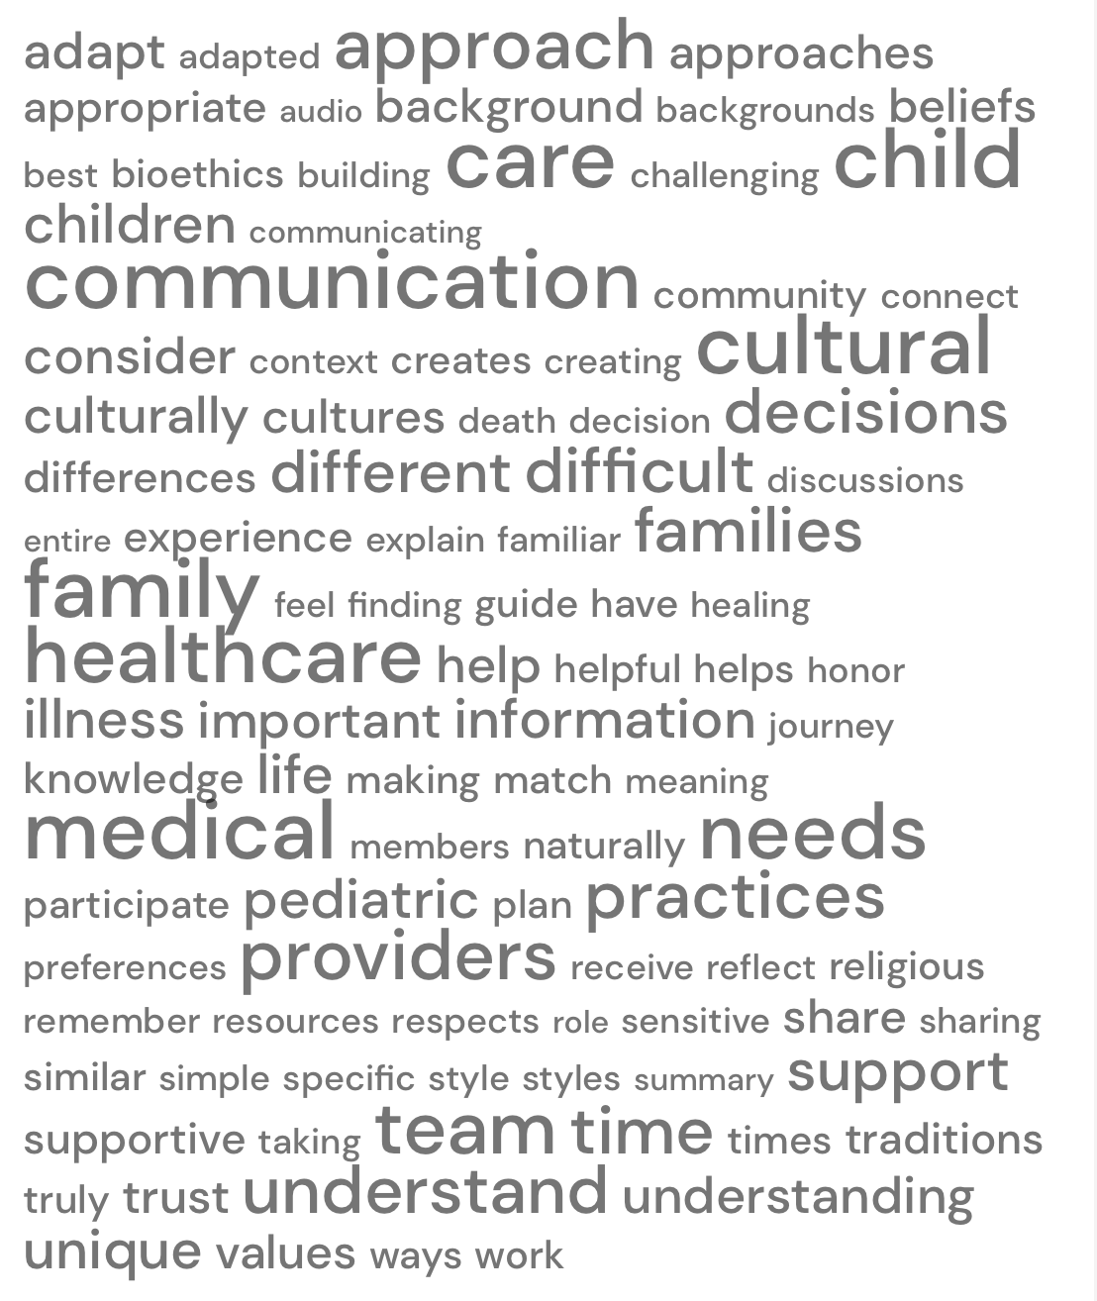
Notes:
What is the product? Showcase your product!
Who is the intended audience?
What is the proposed impact?
Any anticipated barriers to and/or strategies for maximum dissemination?

Slide 11
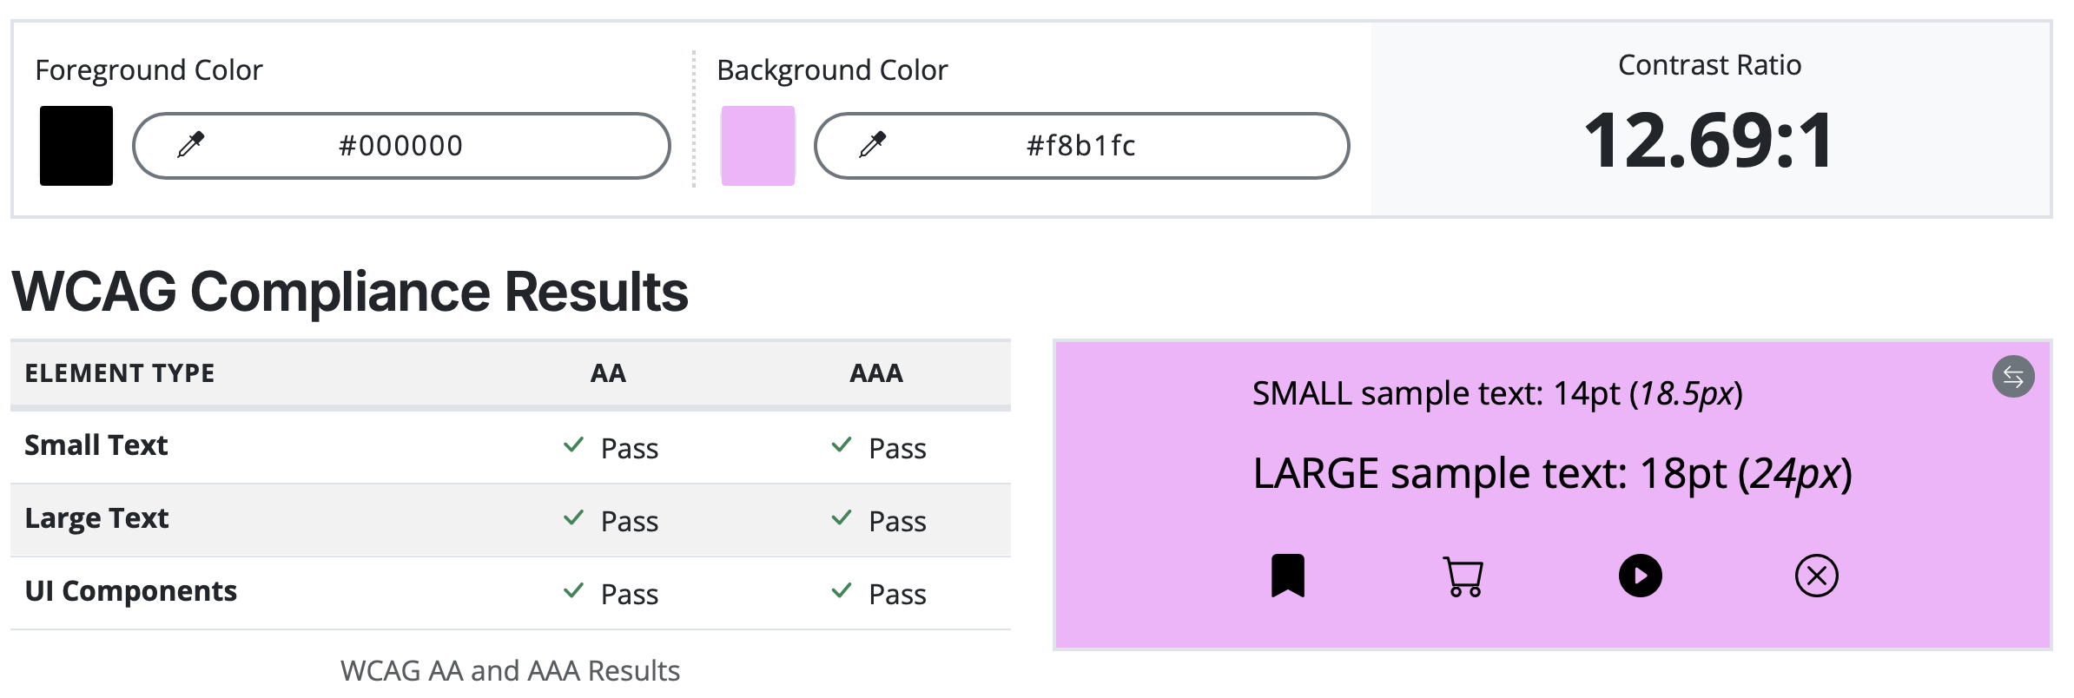
Accessibility
Audio Playback tagged for software to auto play it.
Color contrast is optimal
Sizing is not done in Pixels, but REM values which increase in proportional size compared to Pixels (That may stay fixed).
Notes:
What is the product? Showcase your product!
Who is the intended audience?
What is the proposed impact?
Any anticipated barriers to and/or strategies for maximum dissemination?

Slide 12
Alignment with LEND Values
Family & Person- Centered Perspective:
  Qualitative exploration through personable experiences.
Interdisciplinary Perspective
  Meetings included MDs, Chaplains, MSWs… and more.
Health Equity Perspective
  Addressed open-access issues.
Notes:
Please be sure to include how you integrated the following concepts/ themes
DEI perspectives/ issues
Consultation with Dr. Lewis?
Specific Literature
Family- Person-centered topics/ issues
Consultation with Family Support Scholars?
Consultation with Self-Advocates?
Community Partnerships
Interdisciplinary Lens

Slide 13
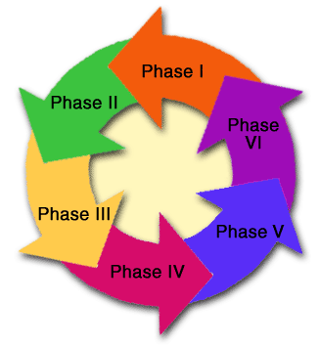
CE Leadership Project
CDCynergy Model for Health Communication
Phase One: Problem definition – Gap in guidelines
Phase Two: Problem analysis – Lack of generalizability
Phase Three: Communication plan – Open-access blog
Phase Four: Evaluation plan – RE-AIM
Phase Five: Implement and Manage – Github and SEO
Phase Six: Feedback – Google feedback form
Notes:
This slide is only for groups with a project on the Continuing Education track. IF your project was Policy or Research you do NOT need to include this slide.

Slide 14
Community (Title V) Agency Interface
Agency: Maternal, Child, and Adolescent Health (MCAH) Program
Purpose: To gather feedback on cultural responsiveness, clarity, and relevance through disseminating the findings using health communication theories.
Notes:
All LP's should plan to consult or interface with a Title V agency​
Which agency is most relevant for your project?​
How might you interface with that agency to gather input on your project?​

Slide 15
Lessons Learned/ Next Steps
Family-centered care should actively try to involve interdisciplinary voices and not just clinicians.
Plain-language and accessible resources are very valuable.
We cannot assume that adult guidelines are generalizable to pediatrics.
Next Steps: Continue working on the project to publish the guidelines.
Notes:
Add anything that you feel is relevant. You may also pose questions to your audience if you want input on your next steps.

Slide 16
Do Digital Softwares Now Use More Realistic
Voices Or Does It Stick to Robotic Voices?

Slide 17
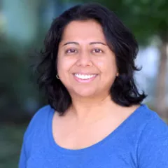

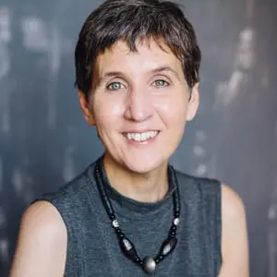
Acknowledgments
CA-LEND
Sheela Rao,
MD
Cary Kreutzer, EdD
Nancy Berlinger, PhD
California
Leadership
Education in
Neurodevelopmental
&
Related Disabilities
Notes:
List any individuals and/or groups who have assisted you with your project.

